Slide 1
Wearable assistive robot for rehabilitation
Yulin – Week 3 (Feb. 22nd – 25th)

Slide 2
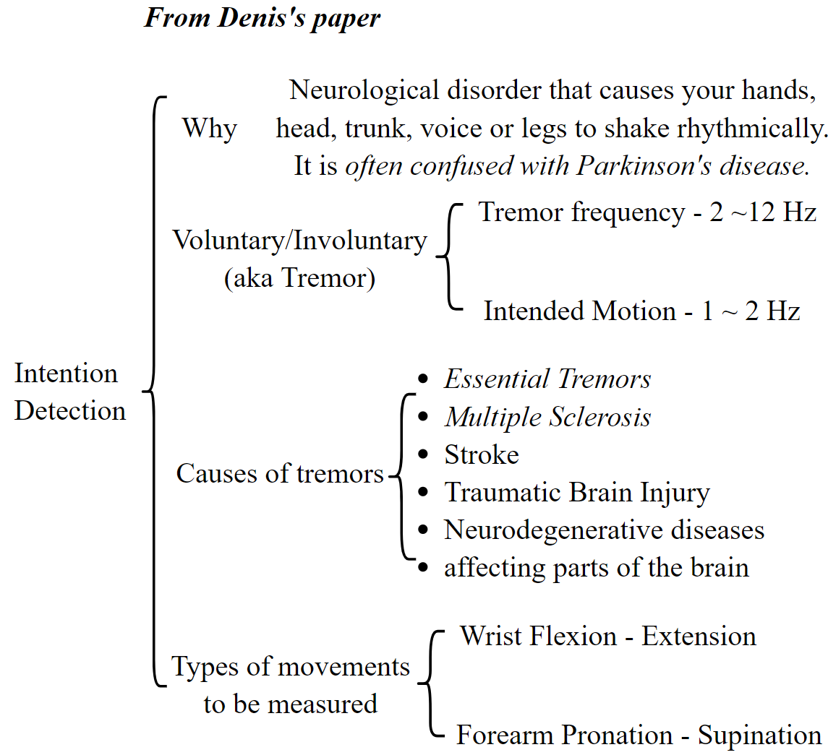
Literature Review
Notes:
As many as 44 million workers in the European Union (EU) are affected by workplace-related musculoskeletal disorders. Exoskeletons have the capacity to decrease the number of musculoskeletal injuries and increase quality of life at work, thereby reducing costs for a company in the long run.
Manufacturing and construction workers, in particular, undertake physically strenuous activities which increase their risk of health problems, disability and sick leave. This leads to lower job attractiveness and job candidate scarcity, resulting in unfilled job openings that slow growth and competitiveness. This is particularly true for many SMEs in the North Sea Region, who are unaware of available solutions via exoskeleton adoption as solution developers tend to target large corporates.

Slide 3
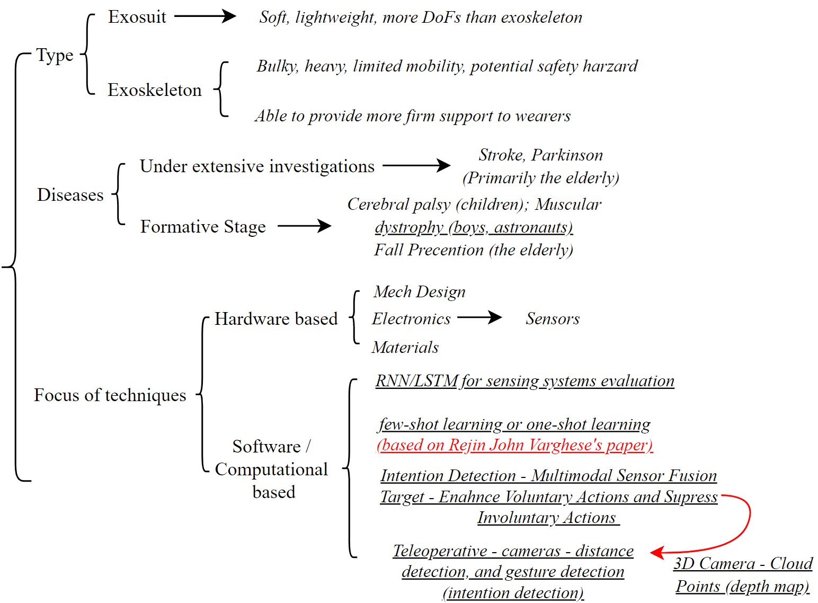
Summary of literatures and prospective angles
Wearable devices
Lower Limb or Upper Limb?
and Rahul Singh’s report

Slide 4
Identification of gaps - Sensors fusion for intention detection
From Rahul Singh’s report (Sensor fusion – Camera and 2 IMUS), potential improvements:
Change the original camera to 3D camera – collect depth data, fused with IMU data (Optimise the position and direction of the IMU) – improve identification of objects
CNN is computationally consuming – short battery life and low portability (as it requires laptop and powerful G/CPU to support CNN) (This is the problem of pretty much all the current wearable devices) – few-shot learning (one image to classify objects – computationally efficient & less power required)
CNN needs to be retrained every time a new object is added, namely, not adaptive to new objects – advanced deep learning/transfer learning (few-shot learning, recommended by the author)
Object detection accuracy – LSTM (integrate temporal information)
From a paper in 2019 – “Transfer learning-based human activity recognition” – first application of FSL into HAR (New)

Slide 5
Thank you!
Any suggestion on how I should better facilitate the project at this stage is more than welcome!

